Slide 1


Playing Video Files with OpenCV
Learn how to open and control videos using Python and OpenCV in this hands-on tutorial. We'll cover loading videos, displaying frames, and controlling playback speed.
by EMRE Akpınar

Slide 2
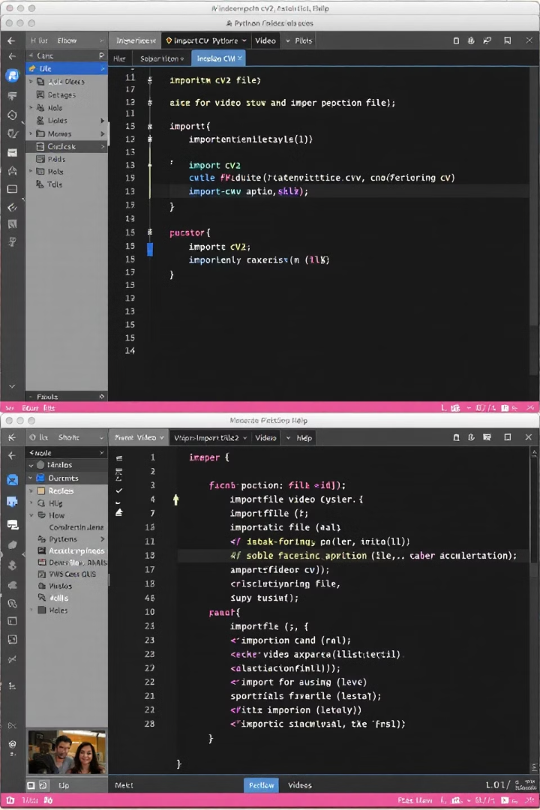
Setting Up Your Project
Create Project
Start by creating a new Python file. Name it "Open_Video.py" for clarity.
Import Library
Import OpenCV with the standard import statement:
import cv2
Prepare Video
Have a video file ready. We'll use "street.mp4" in this example.

Slide 3
Loading Video Files
VideoCapture Object
Check If Opened
Use cv2.VideoCapture() with the file path as argument. Unlike cameras, use a string instead of an index number.
Always verify if the file opened successfully with isOpened().
cap = cv2.VideoCapture("street.mp4")
if cap.isOpened():
# Continue processing
else:
print("Error: Unable to access the video.")

Slide 4

Reading Video Frames
1
Set Up Loop
2
Read Each Frame
Create a while loop that continues as long as the video is open.
Use cap.read() to get the next frame. It returns two values: a success flag and the frame itself.
3
Check Success
Verify the frame was read successfully before processing.

Slide 5
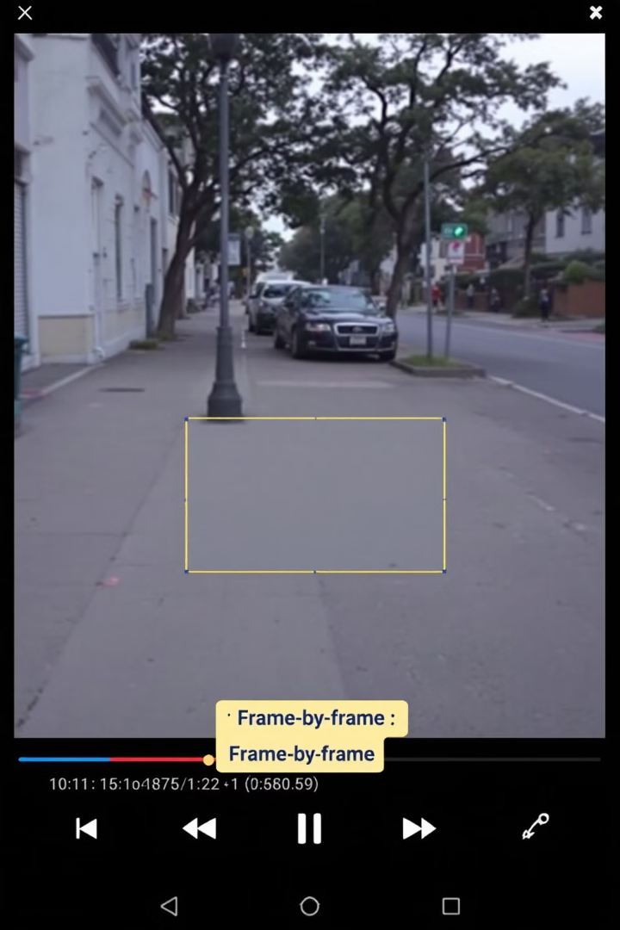
Displaying Video Frames
Show Frame
Wait For Key
Display each frame using cv2.imshow("Window Name", frame).
Add cv2.waitKey(delay) to control frame rate and check for keypresses.
Exit Condition
Break the loop when 'q' is pressed: if cv2.waitKey(delay) & 0xFF == ord('q').

Slide 6




Controlling Playback Speed
Too Fast
Without delay, frames display as fast as your computer can process them.
Calculate Delay
Standard video uses 24 frames per second. Calculate millisecond delay: 1000 ÷ 24.
Set Delay
Use cv2.waitKey(1000 // 24) for natural playback speed.

Slide 7
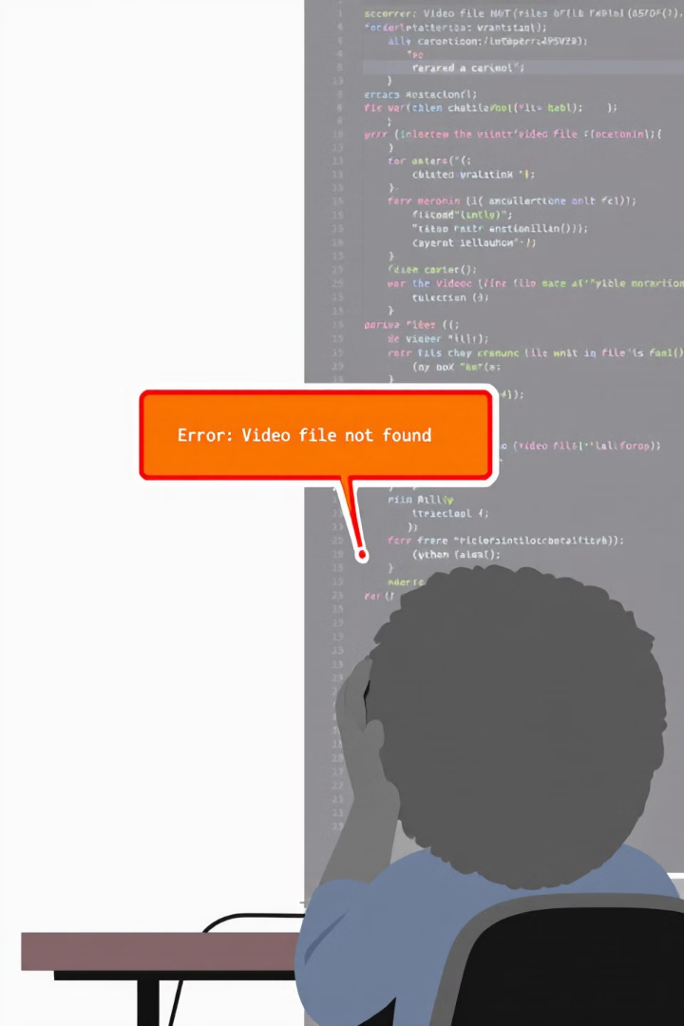



Error Handling
Check File Existence
Display Messages
Graceful Exit
Release resources even if errors occur to prevent memory leaks.
Always verify if the video file exists and can be opened.
Provide clear error messages to help users identify problems.

Slide 8




Complete Code Example
Import
1
Initialize
Import the OpenCV library
2
Create VideoCapture object with the video path
Clean Up
4
Process
Release resources when finished
3
Read and display frames in a controlled loop
import cv2
cap = cv2.VideoCapture("street.mp4")
if not cap.isOpened():
print("Error: Unable to access the video.")
else:
while cap.isOpened():
ret, frame = cap.read()
if ret:
cv2.imshow("Video", frame)
if cv2.waitKey(1000 // 24) & 0xFF == ord('q'):
break
else:
break
cap.release()
cv2.destroyAllWindows()

